Slide 1
Display Week Data for Exhibitors
Based on Display Week 2014

Slide 2
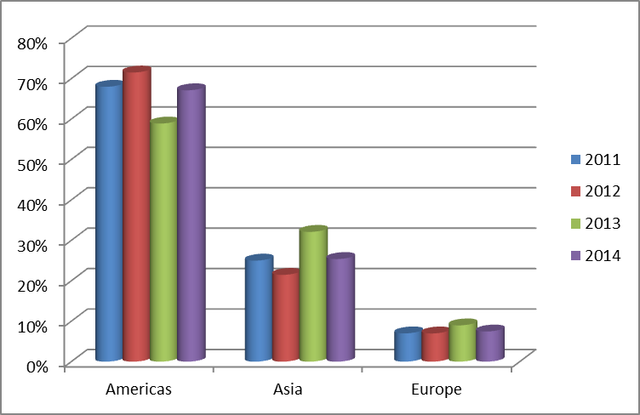
Attendees by Region
2014 saw regional attendance pattern return to normal.
This appears to have been driven by a large increase in attendance, especially from USA, whereas 2013’s show in Canada had lower attendance from USA.

Slide 3
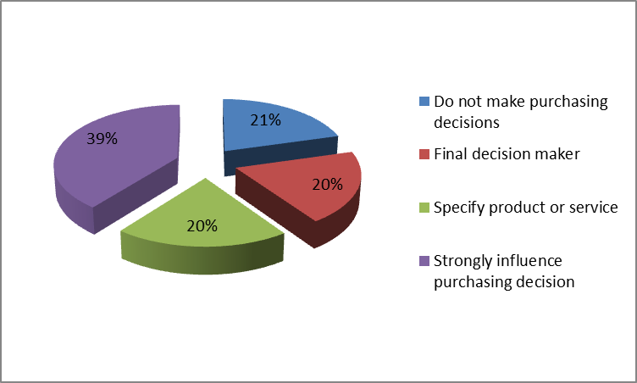
Attendee Purchasing Influence
Display Week attendees are influential technologists and business leaders
79% of attendees influence purchasing decisions

Slide 4
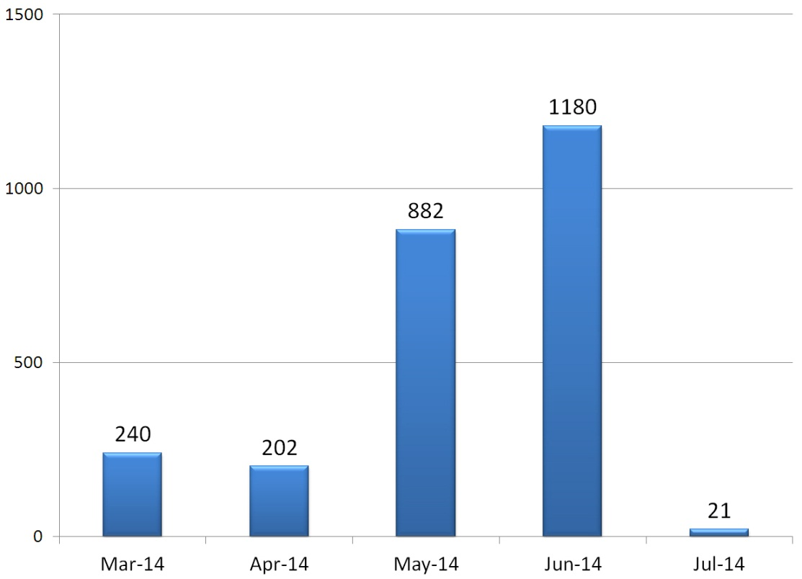
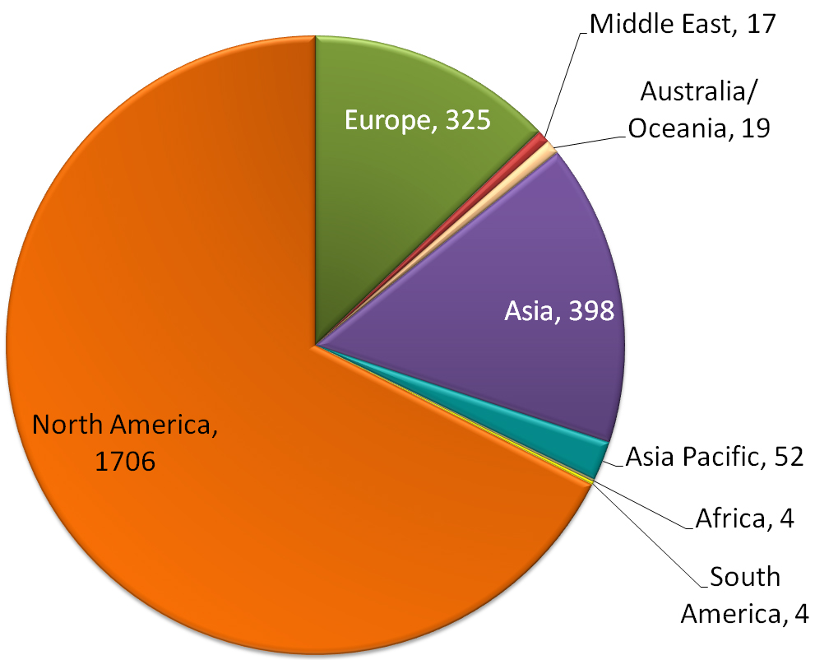
Display Week 2014 Media Coverage

